Slide 1
Breast Cancer Diagnosis
Project Presentation for the Data Analytics Course by Shubham Jagtap

Slide 2
INDEX:
[{"metadata":{},"cell_type":"markdown","source":"# Decision Tree Classifier"}]
Intorduction
Breast Cancer: An Overview
Why I am using Machine Learning
OBJECTIVE:
Model Building
Logistic Regression
Naive Bayes Classifier
K – Nearest Neighbor Classifier
Decision Tree Classifier
Adaboost Classifier
Random Forest Classifier
Support vector classifier
Results
Conclusion

Slide 3
Introduction
What is meachine Learning and why we are using it?
Machine Learning(ML) is field of artificial intelligence that uses statistical
techniques to give computer systems the ability to ‘learn’ (e.g. progressively
improve performance on specific task) form data, without being explicitly
programmed.
Self Thinking
Computer
AI
ML
Provides
Mathmatical
Tool to Al

Slide 4
Breast Cancer: An Overview
Breast cancer is the Second Leading cause of cancer death in women,second only to lung cancer.
The leading risk factor for breast cancer is simply being a woman. Though breast cancer done occer in men, the disease in 100 times more common in women.
Men can also breast cancer.In 2017 ,the American Cancer Society Estimates 2,470 new cases of invasive breast cancer will be diagnosed in men is the U.S.
A woman has about a one in eight chance of being diaganosed with breast cancer in her lifetime, according to the National Cncer Institue.
Most women(about eight out of 10 )who get breast cancer do not have a fimaly history of the disease.
But women who have close blood relatives with breast cancer have a higer risk,Having a first-degree relative (mother,sister or daughter )with breast cancer almost doubles a woman’s risk.

Slide 5
Why I am using Machine Learning
Breast
Cancer
Biopsy
Data
Machine
Learning
Diagnosis
+
=

Slide 6
OBJECTIVE:
We have extracted features of breast cancer patient cells and normal person cells. As a Machine learning engineer / Data Scientist has to create an ML model to classify malignant and benign tumor. To complete this ML project we are using the supervised machine learning classifier algorithm.

Slide 7
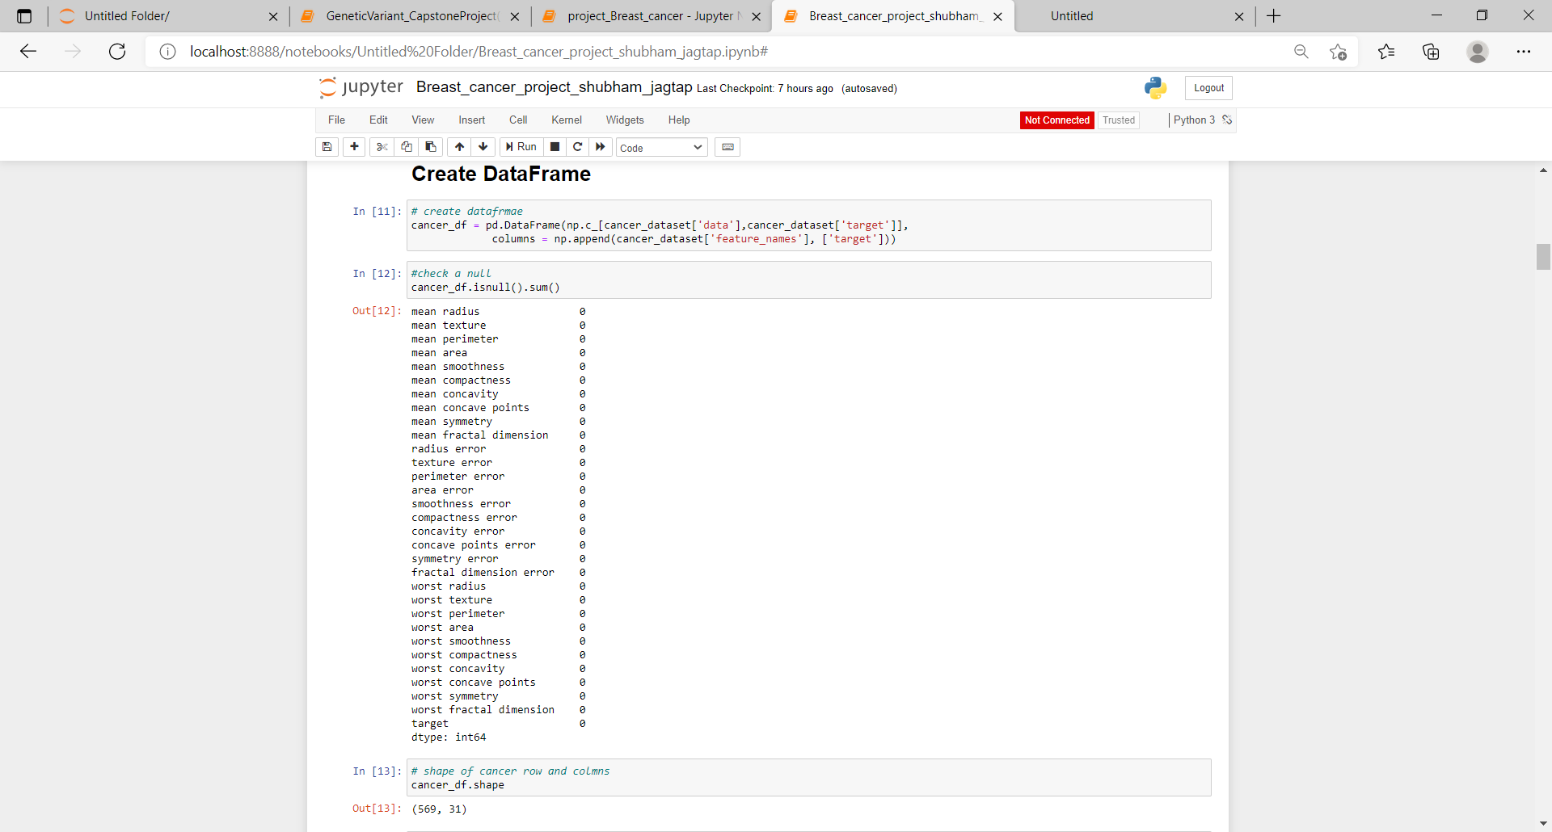
Creat DataFrame
Number of Features :31
Number of obervations:569

Slide 8
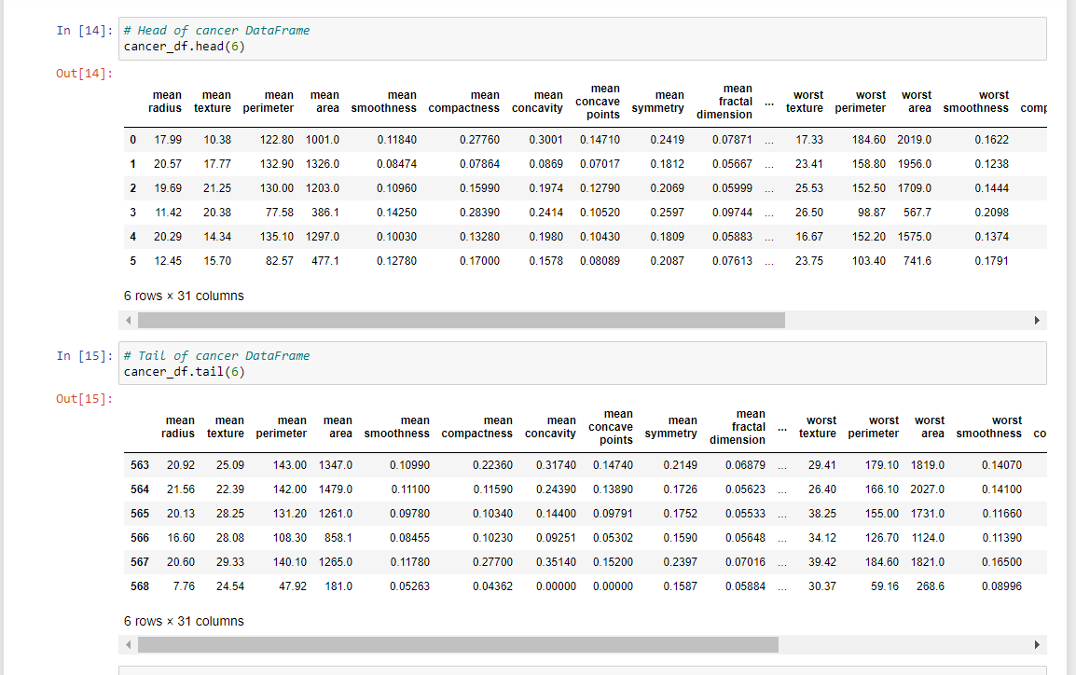
Number of top 5 record
Number of top last record

Slide 9
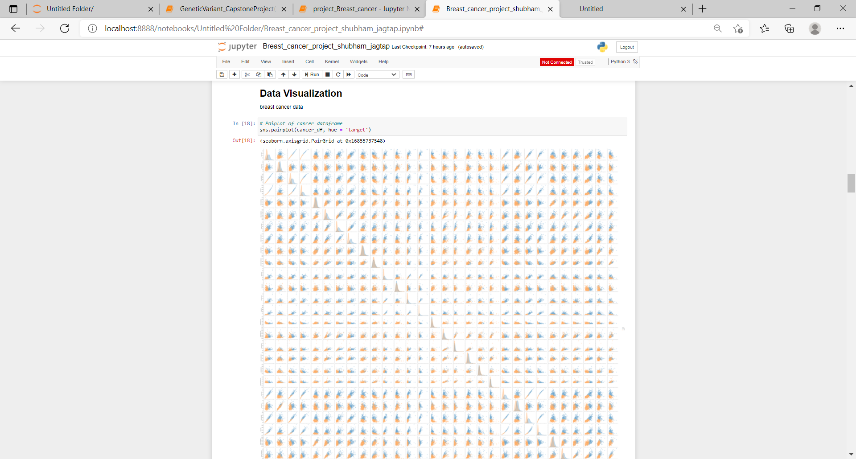
Data Visualization

Slide 10
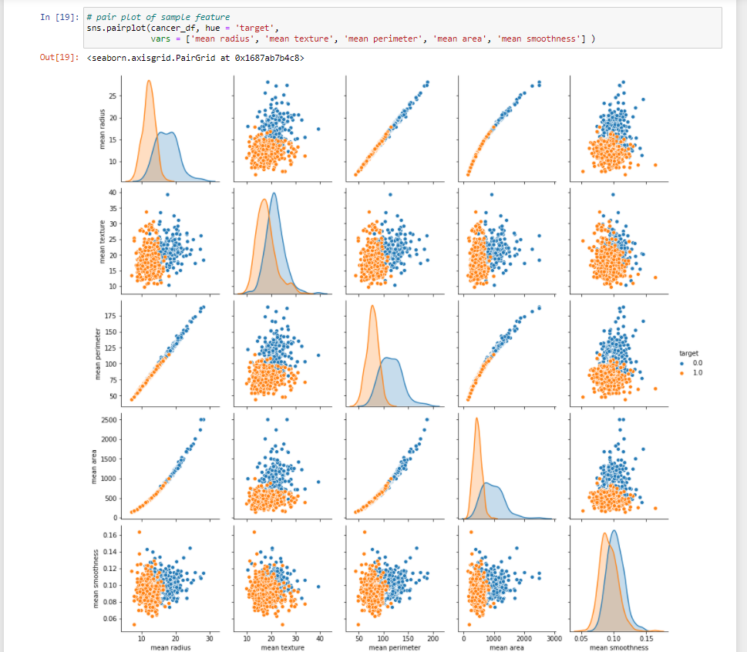
Pair Plot of sample feature

Slide 11
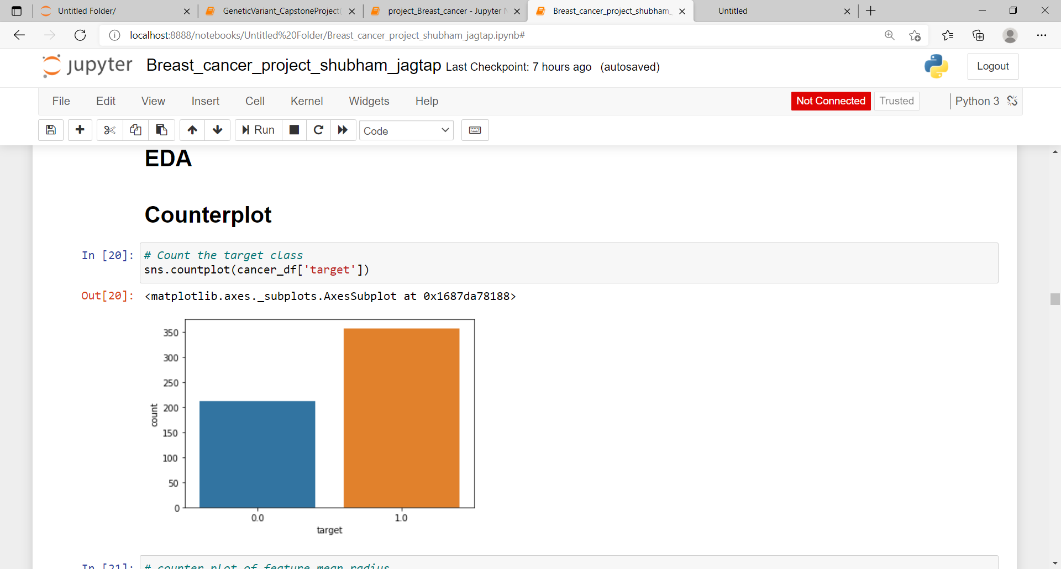
EDA

Slide 12
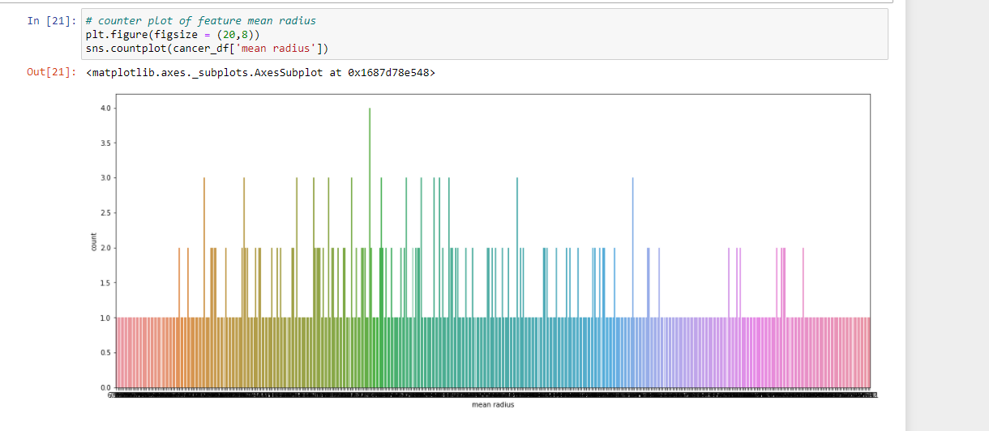
Counter pot of feature mean radius

Slide 13
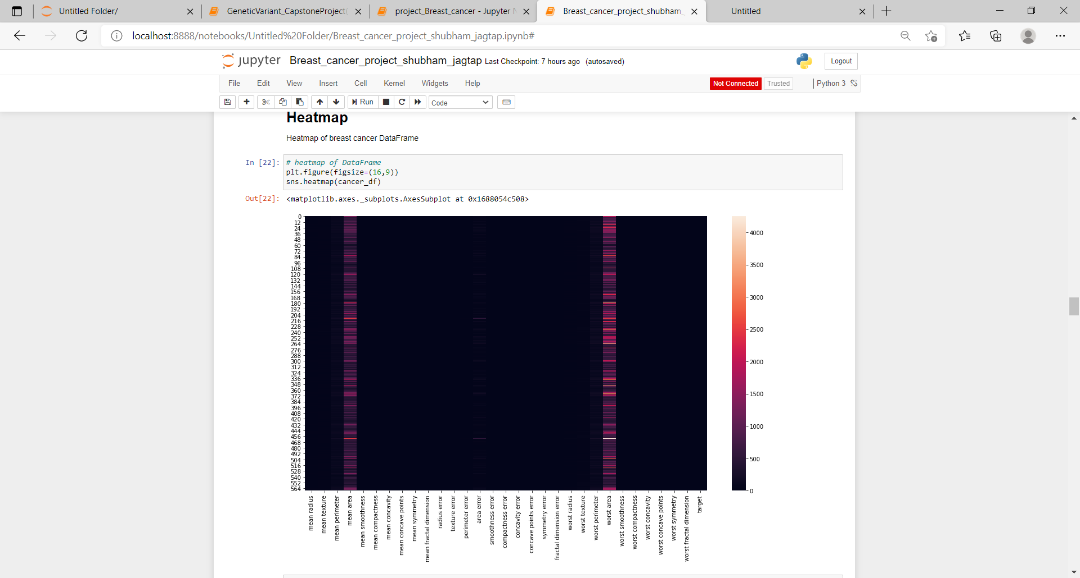
Heatmap

Slide 14
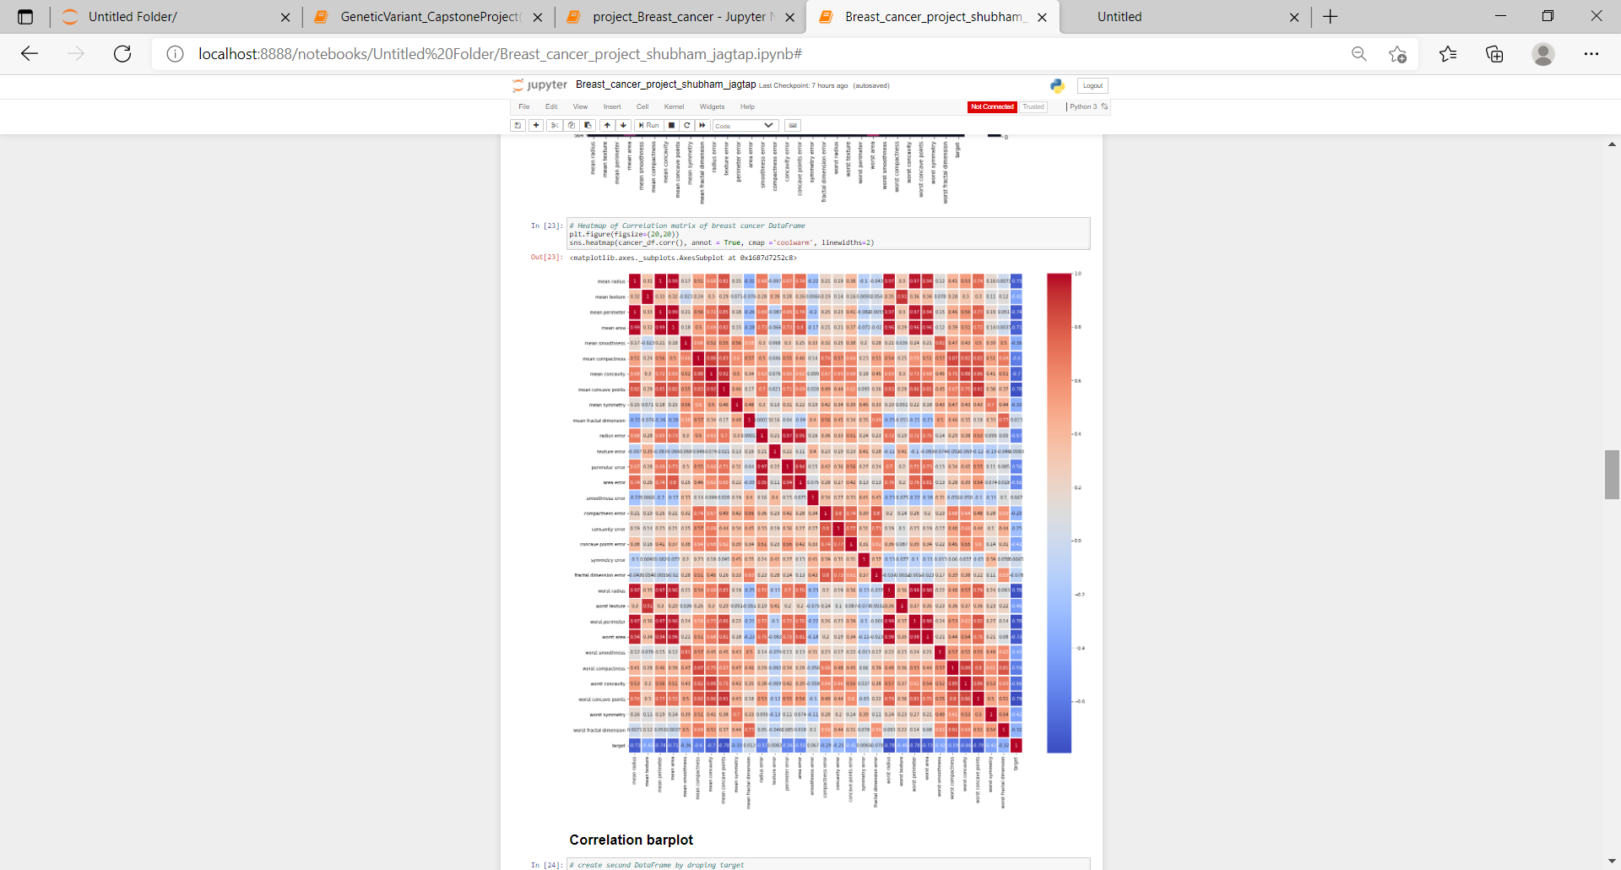
Correlation Matrix

Slide 15
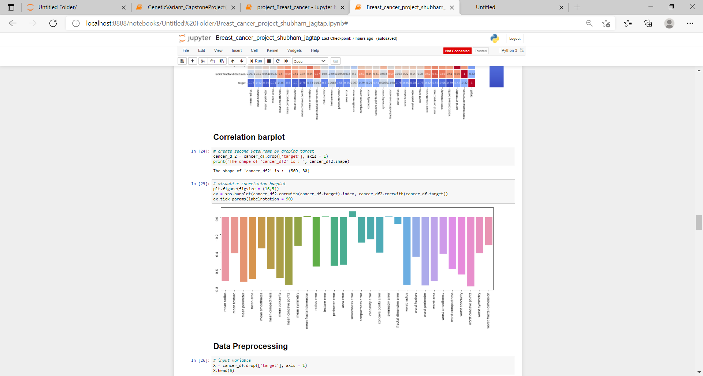
Correlation barplot

Slide 16
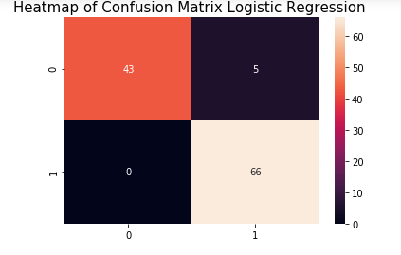
Logistic Regression
Logistic Regressionaccuray=0.9561
TPR=0.92
FPR=0.0

Slide 17
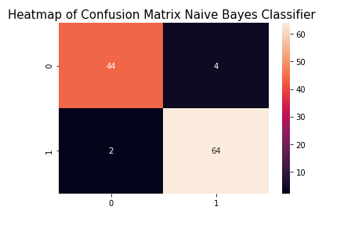
Naive Bayes Classifier
34%
Naive Bayes Classifier accuracy=0.9473
TPR=0.9411
FPR=0.0434

Slide 18
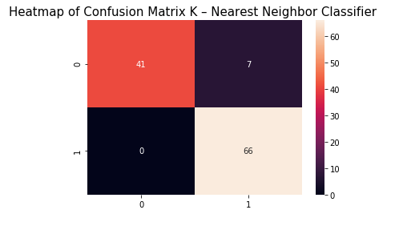
K – Nearest Neighbor Classifier
K – Nearest Neighbor Classifier accuracy=0.9325
TPR=0.9041
FPR=0.0

Slide 19
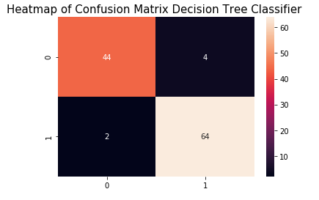
Decision Tree Classifier
Decision Tree Classifier accuracy=0.9473
TPR=0.9411
FRP=0.0434

Slide 20
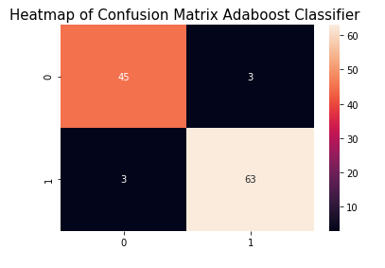
Adaboost Classifier
Adaboost Classifier accuracy=0.9473
TPR=0.9545
FPR=0.0625

Slide 21

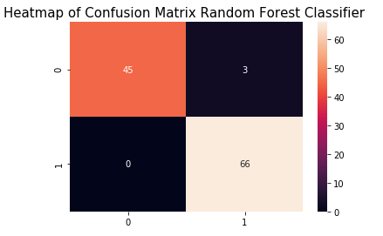
Random Forest Classifier
Random Forest Classifier accuracy=0.9736
TPR=0.9565
FPR=0.0

Slide 22
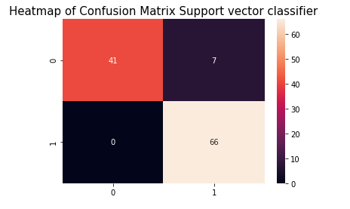
Support vector classifier
Support vector classifier accuracy=0.9385
TPR=0.9041
FPR=0.0

Slide 23
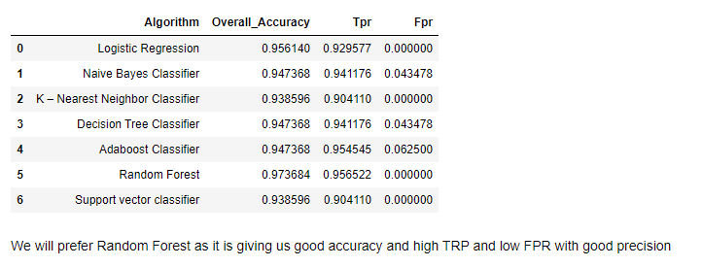
Results

Slide 24
Conclusion
To get more accuracy, we trained all supervised classification algorithms but you can try out a few of them which are always popular. After training all algorithms, we found that Logistic Regression and Random Forest are given high accuracy than remain but we have chosen Random Forest .
As ML Engineer, we always retrain the deployed model after some period of time to sustain the accuracy of the model. We hope our efforts will save the life of breast cancer patients.
Please share your feedback and doubt regarding this ML project, so we can update it.

